Slide 1



BI_360
View in Power BI
Last data refresh:
9/25/2024 3:27:14 AM UTC
Downloaded at:
9/25/2024 3:52:32 AM UTC

Slide 2
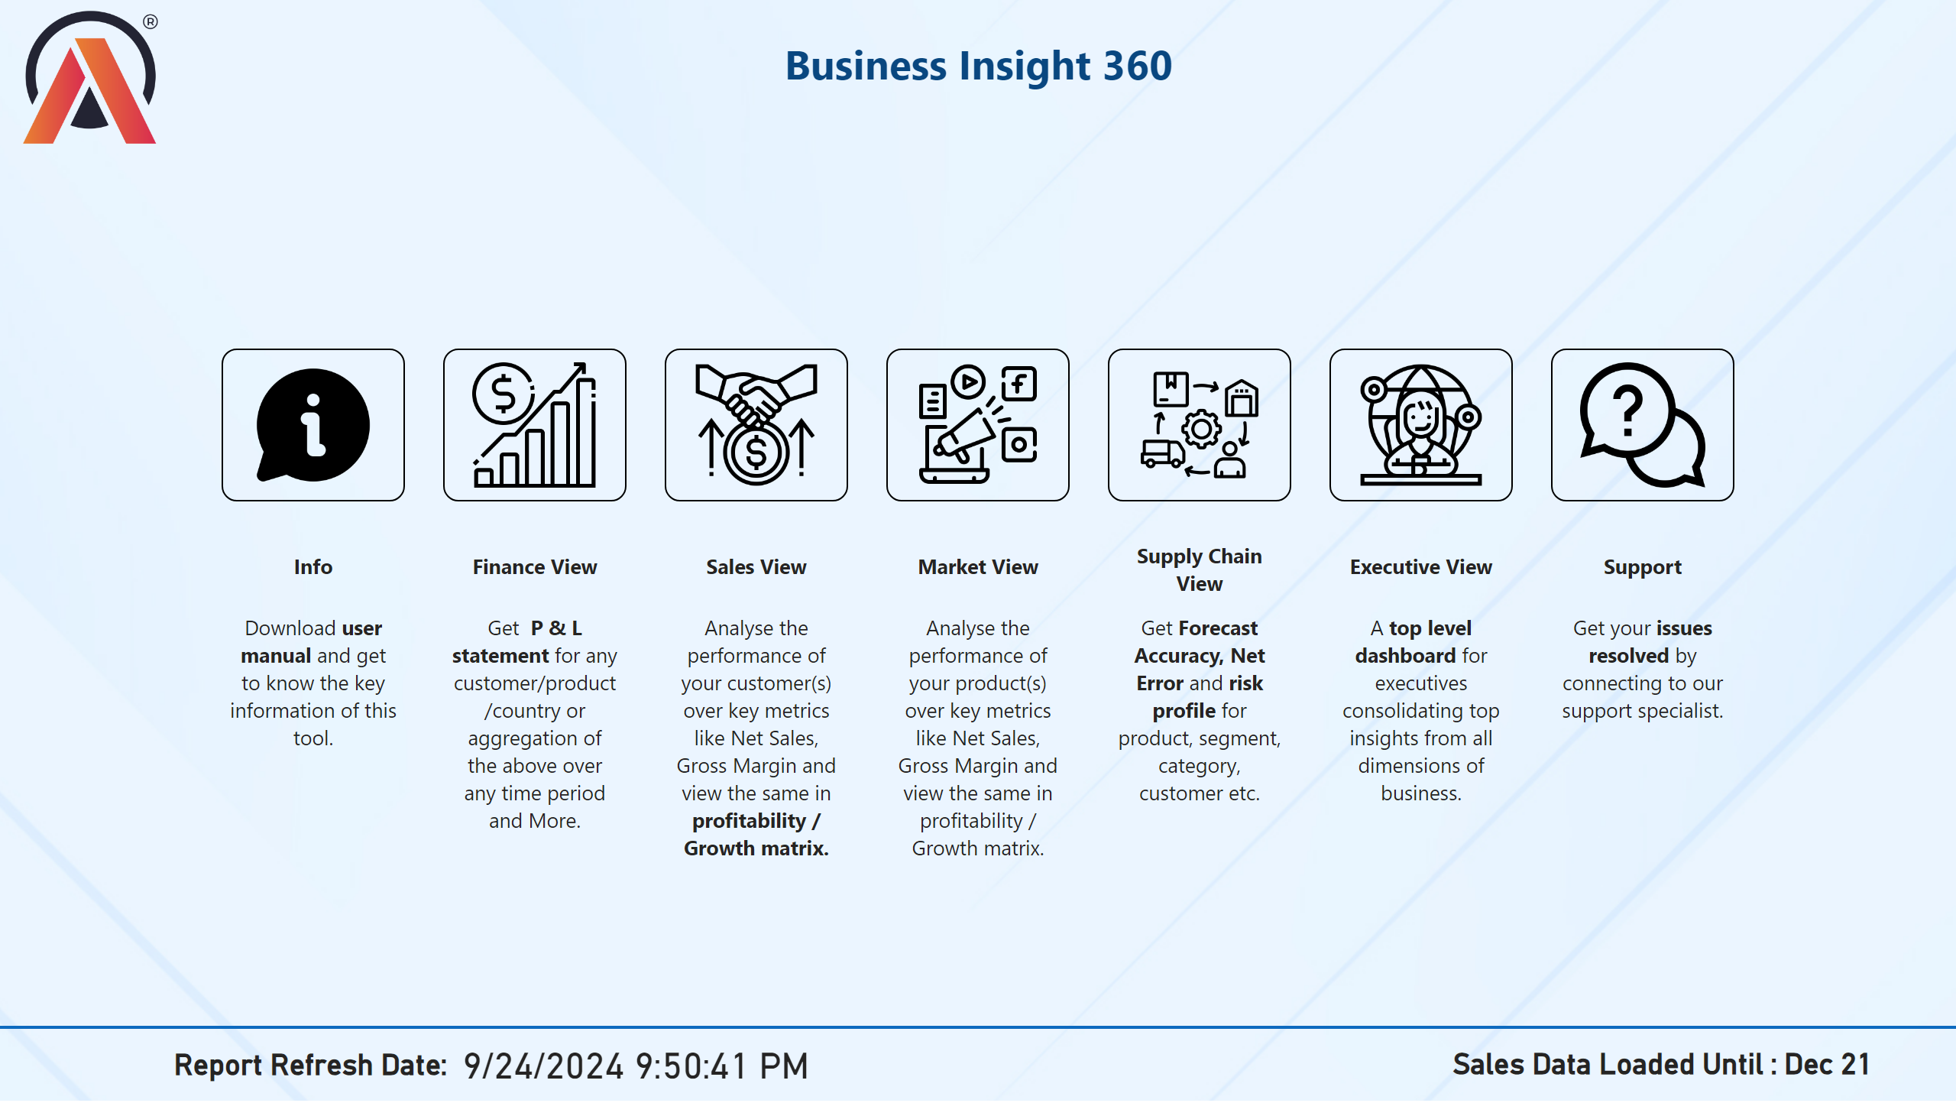
Home
Notes:
image
No alt text provided
image
No alt text provided
image
No alt text provided
image
No alt text provided
image
No alt text provided
image
No alt text provided
image
No alt text provided
textbox
No alt text provided
image
No alt text provided
textbox
No alt text provided
textbox
No alt text provided
textbox
No alt text provided
textbox
No alt text provided
textbox
No alt text provided
textbox
No alt text provided
textbox
No alt text provided
textbox
No alt text provided
textbox
No alt text provided
textbox
No alt text provided
textbox
No alt text provided
textbox
No alt text provided
textbox
No alt text provided
textbox
No alt text provided
shape
No alt text provided
card
No alt text provided
card
No alt text provided
card
No alt text provided

Slide 3
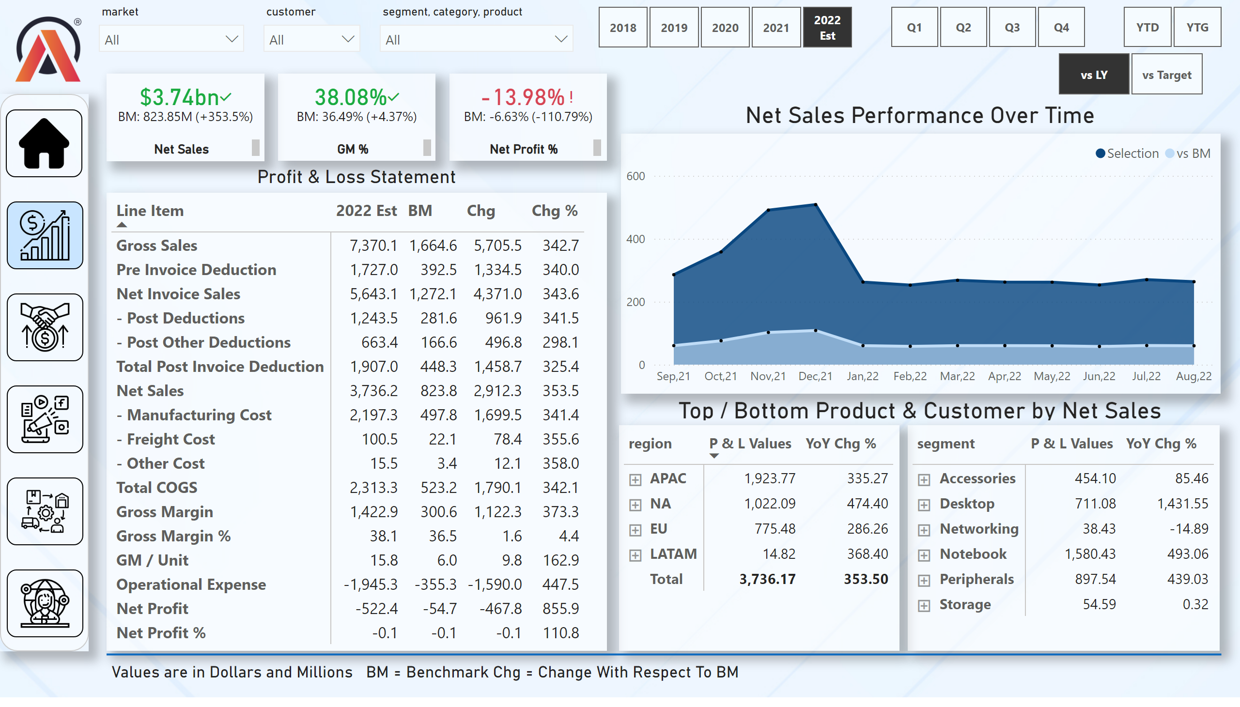
Finance View
Notes:
pivotTable
No alt text provided
slicer
No alt text provided
slicer
No alt text provided
slicer
No alt text provided
Net Sales Performance Over Time
No alt text provided
pivotTable
No alt text provided
pivotTable
No alt text provided
card
No alt text provided
card
No alt text provided
textbox
No alt text provided
slicer
No alt text provided
slicer
No alt text provided
slicer
No alt text provided
kpi
No alt text provided
textbox
No alt text provided
kpi
No alt text provided
textbox
No alt text provided
kpi
No alt text provided
textbox
No alt text provided
image
No alt text provided
shape
No alt text provided
image
No alt text provided
image
No alt text provided
image
No alt text provided
image
No alt text provided
image
No alt text provided
image
No alt text provided
slicer
No alt text provided
card
No alt text provided
textbox
No alt text provided
shape
No alt text provided

Slide 4
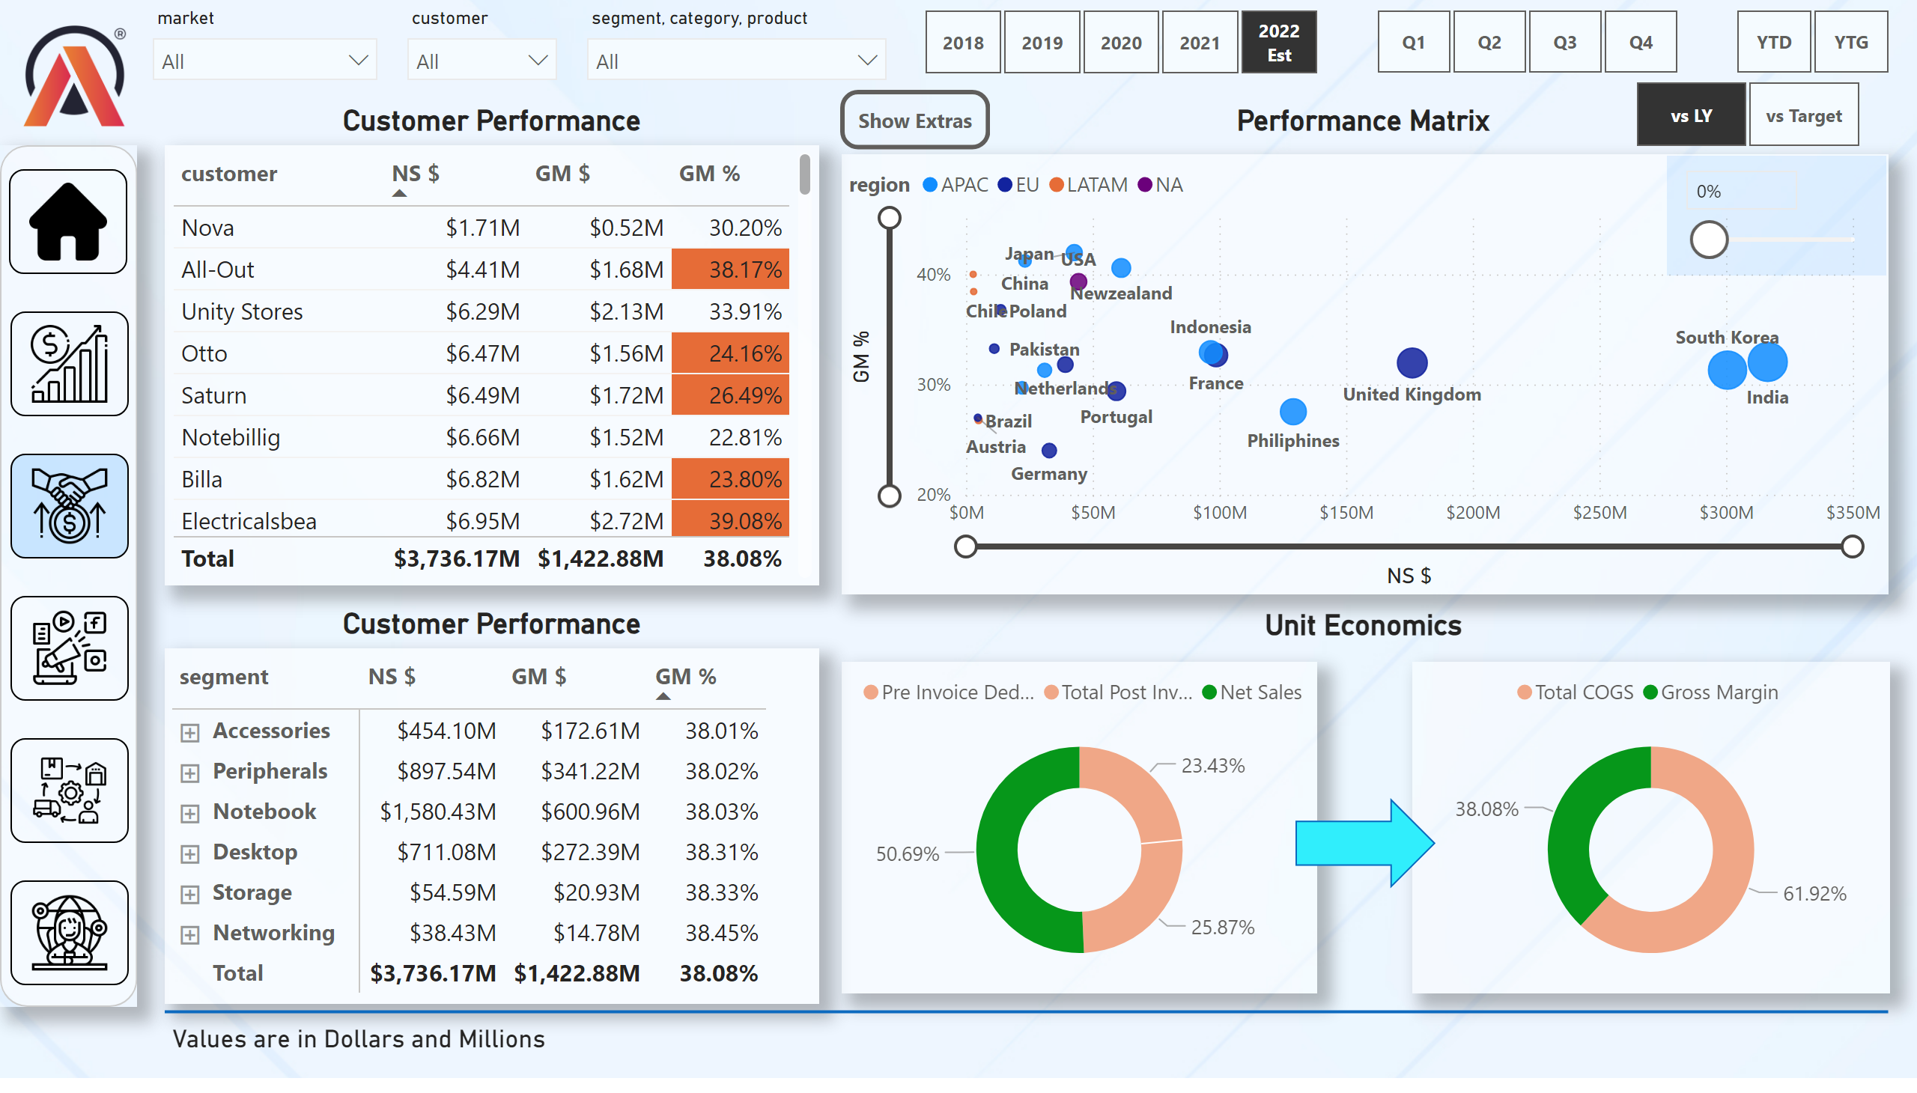
Sales View
Notes:
slicer
No alt text provided
slicer
No alt text provided
slicer
No alt text provided
textbox
No alt text provided
slicer
No alt text provided
slicer
No alt text provided
slicer
No alt text provided
image
No alt text provided
shape
No alt text provided
image
No alt text provided
image
No alt text provided
image
No alt text provided
image
No alt text provided
image
No alt text provided
image
No alt text provided
tableEx
No alt text provided
pivotTable
No alt text provided
scatterChart
No alt text provided
textbox
No alt text provided
textbox
No alt text provided
textbox
No alt text provided
donutChart
No alt text provided
donutChart
No alt text provided
slicer
No alt text provided
slicer
No alt text provided
shape
No alt text provided
textbox
No alt text provided
shape
No alt text provided
actionButton
No alt text provided

Slide 5
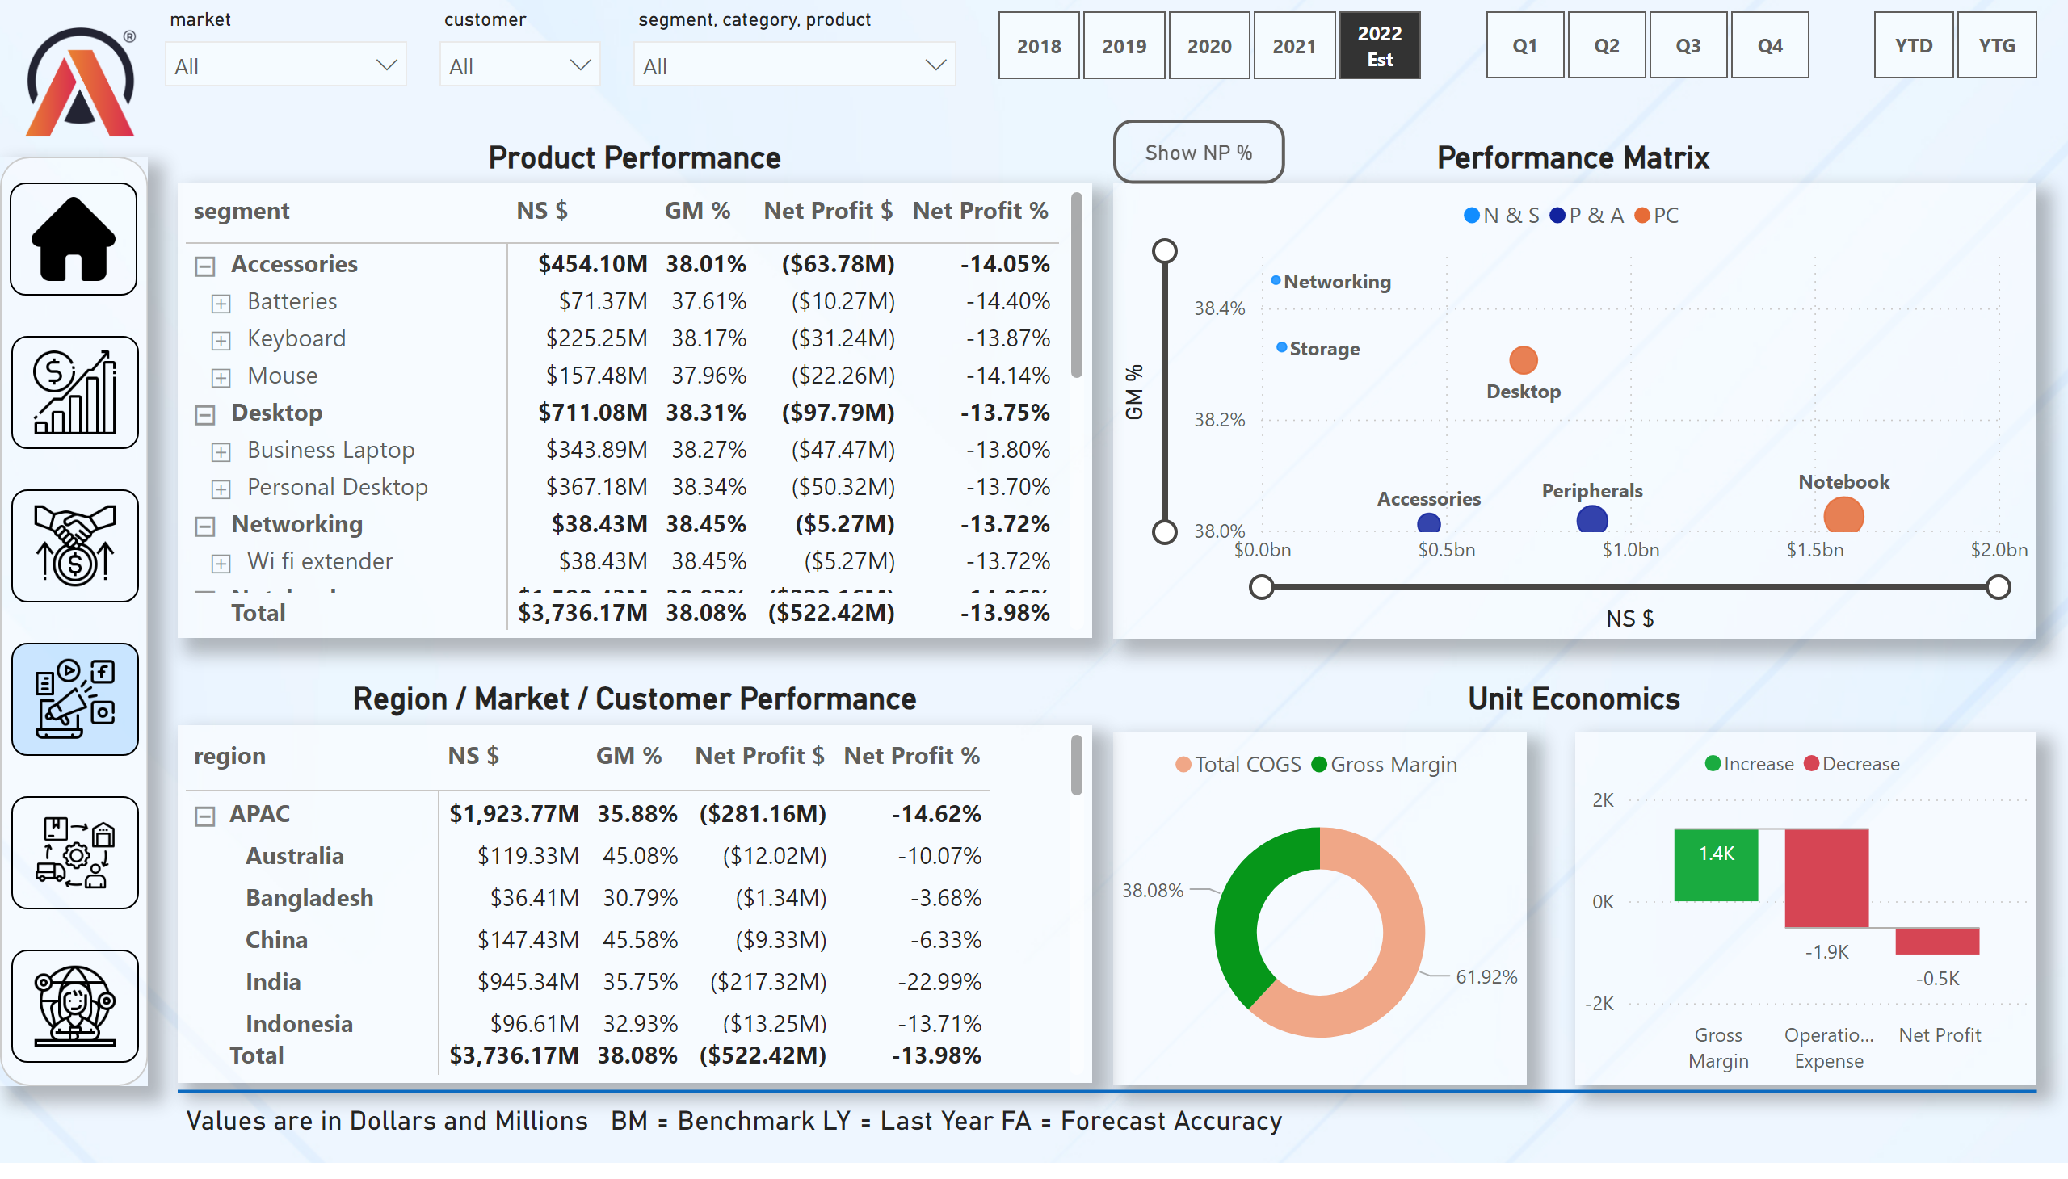
Market View
Notes:
slicer
No alt text provided
slicer
No alt text provided
slicer
No alt text provided
textbox
No alt text provided
slicer
No alt text provided
slicer
No alt text provided
slicer
No alt text provided
image
No alt text provided
shape
No alt text provided
image
No alt text provided
image
No alt text provided
image
No alt text provided
image
No alt text provided
image
No alt text provided
image
No alt text provided
textbox
No alt text provided
textbox
No alt text provided
textbox
No alt text provided
donutChart
No alt text provided
pivotTable
No alt text provided
pivotTable
No alt text provided
waterfallChart
No alt text provided
Show NP %
No alt text provided
GM % Plot
No alt text provided
actionButton
No alt text provided
scatterChart
No alt text provided
textbox
No alt text provided
shape
No alt text provided

Slide 6
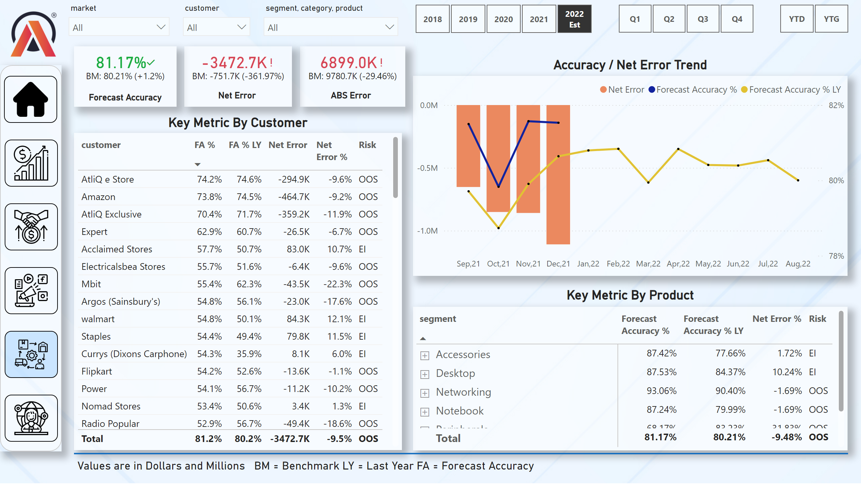
Supply Chain View
Notes:
slicer
No alt text provided
slicer
No alt text provided
slicer
No alt text provided
textbox
No alt text provided
slicer
No alt text provided
slicer
No alt text provided
slicer
No alt text provided
kpi
No alt text provided
textbox
No alt text provided
kpi
No alt text provided
textbox
No alt text provided
image
No alt text provided
shape
No alt text provided
image
No alt text provided
image
No alt text provided
image
No alt text provided
image
No alt text provided
image
No alt text provided
image
No alt text provided
tableEx
No alt text provided
lineClusteredColumnComboChart
No alt text provided
pivotTable
No alt text provided
textbox
No alt text provided
textbox
No alt text provided
kpi
No alt text provided
textbox
No alt text provided
shape
No alt text provided
textbox
No alt text provided

Slide 7
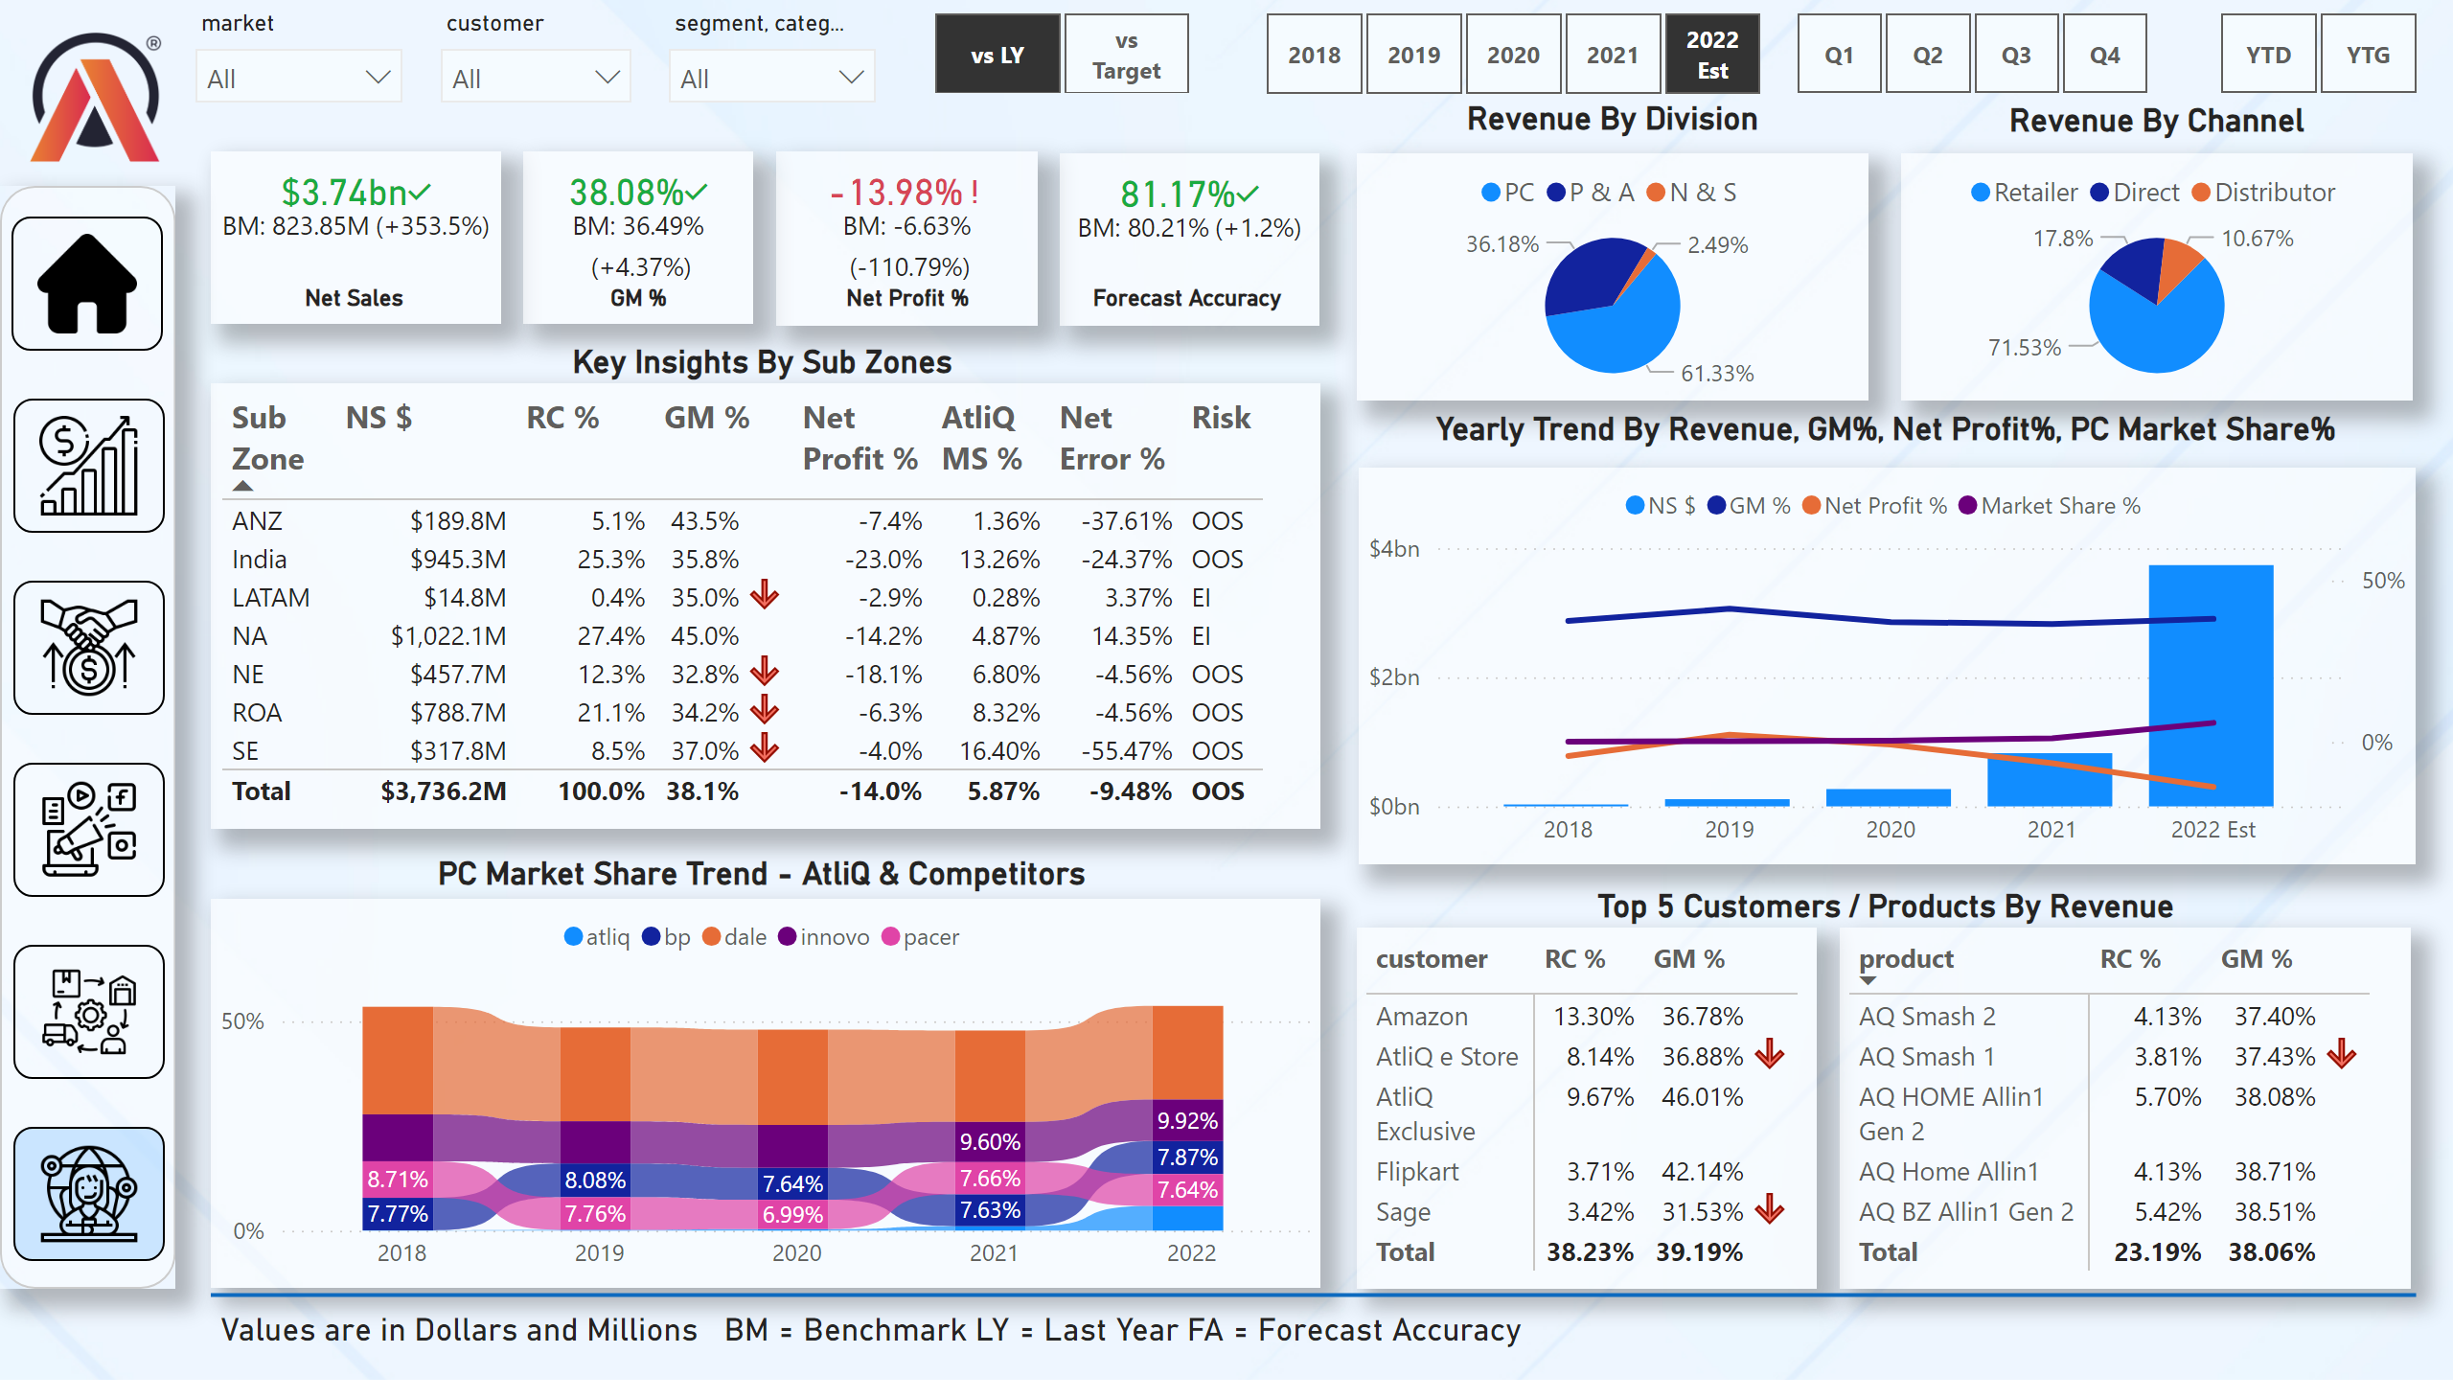
Executive View
Notes:
tableEx
No alt text provided
slicer
No alt text provided
slicer
No alt text provided
slicer
No alt text provided
pivotTable
No alt text provided
textbox
No alt text provided
slicer
No alt text provided
slicer
No alt text provided
slicer
No alt text provided
kpi
No alt text provided
textbox
No alt text provided
kpi
No alt text provided
textbox
No alt text provided
kpi
No alt text provided
textbox
No alt text provided
image
No alt text provided
shape
No alt text provided
image
No alt text provided
image
No alt text provided
image
No alt text provided
image
No alt text provided
image
No alt text provided
image
No alt text provided
slicer
No alt text provided
card
No alt text provided
kpi
No alt text provided
textbox
No alt text provided
pieChart
No alt text provided
textbox
No alt text provided
pieChart
No alt text provided
textbox
No alt text provided
lineClusteredColumnComboChart
No alt text provided
textbox
No alt text provided
ribbonChart
No alt text provided
textbox
No alt text provided
textbox
No alt text provided
pivotTable
No alt text provided
shape
No alt text provided
textbox
No alt text provided

Slide 8
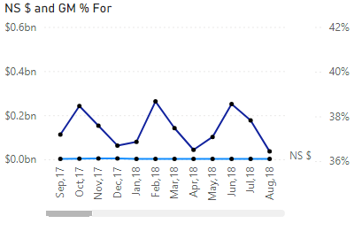
Sales Tooltip
Notes:
NS $ and GM % For
No alt text provided

Slide 9
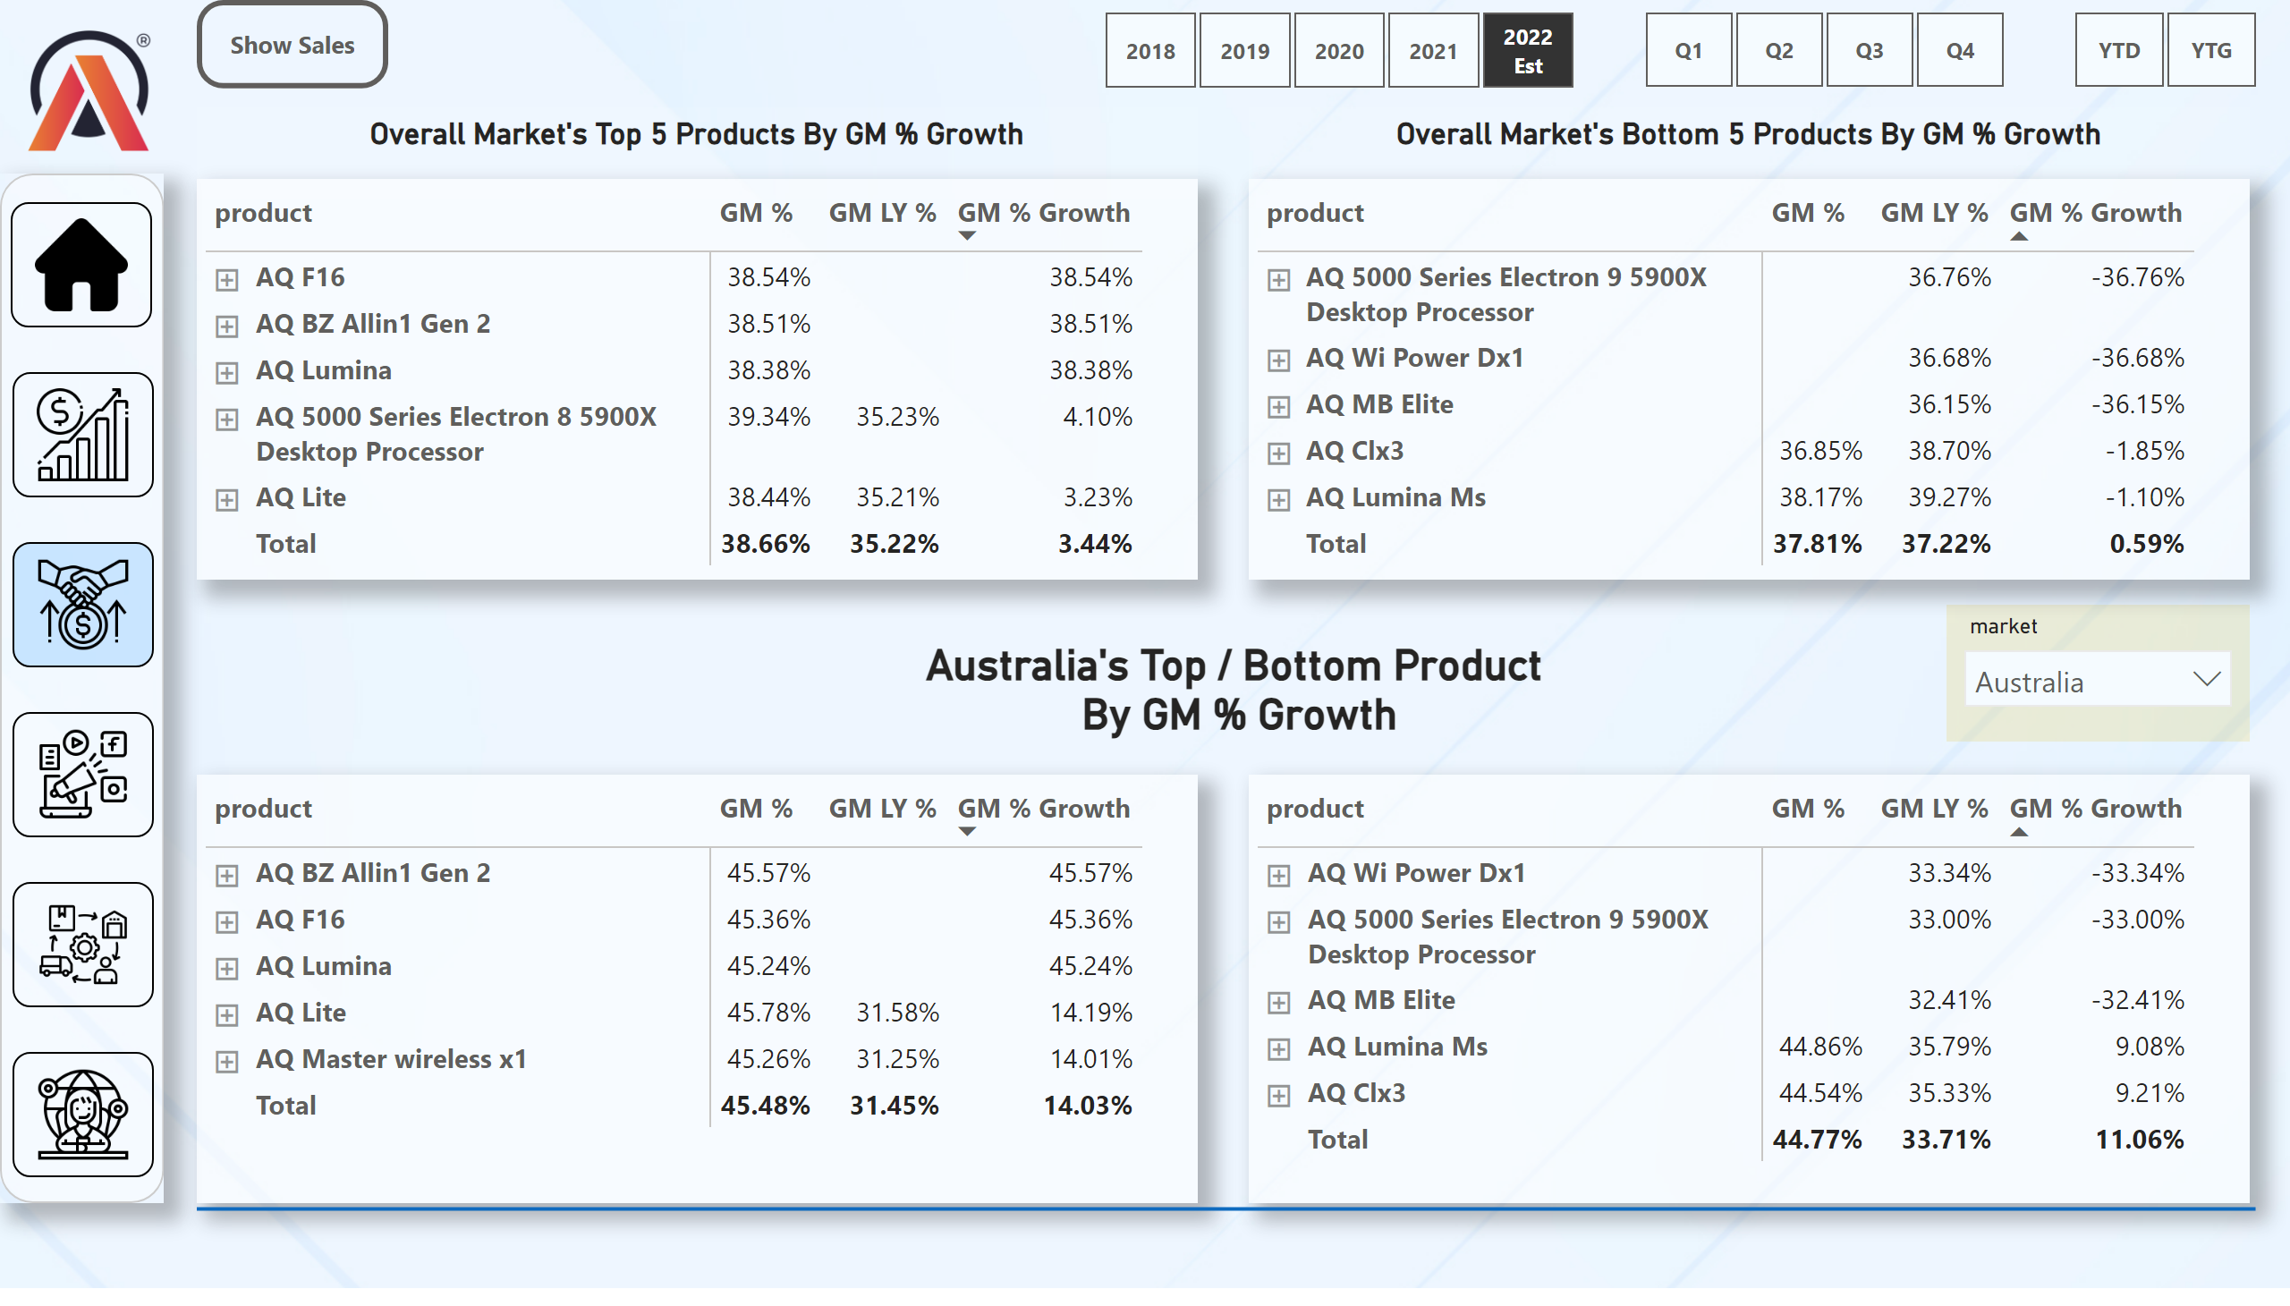
Extra Sales View
Notes:
slicer
No alt text provided
slicer
No alt text provided
slicer
No alt text provided
slicer
No alt text provided
image
No alt text provided
shape
No alt text provided
image
No alt text provided
image
No alt text provided
image
No alt text provided
image
No alt text provided
image
No alt text provided
image
No alt text provided
pivotTable
No alt text provided
pivotTable
No alt text provided
textbox
No alt text provided
textbox
No alt text provided
card
No alt text provided
pivotTable
No alt text provided
pivotTable
No alt text provided
shape
No alt text provided
actionButton
No alt text provided

Slide 10
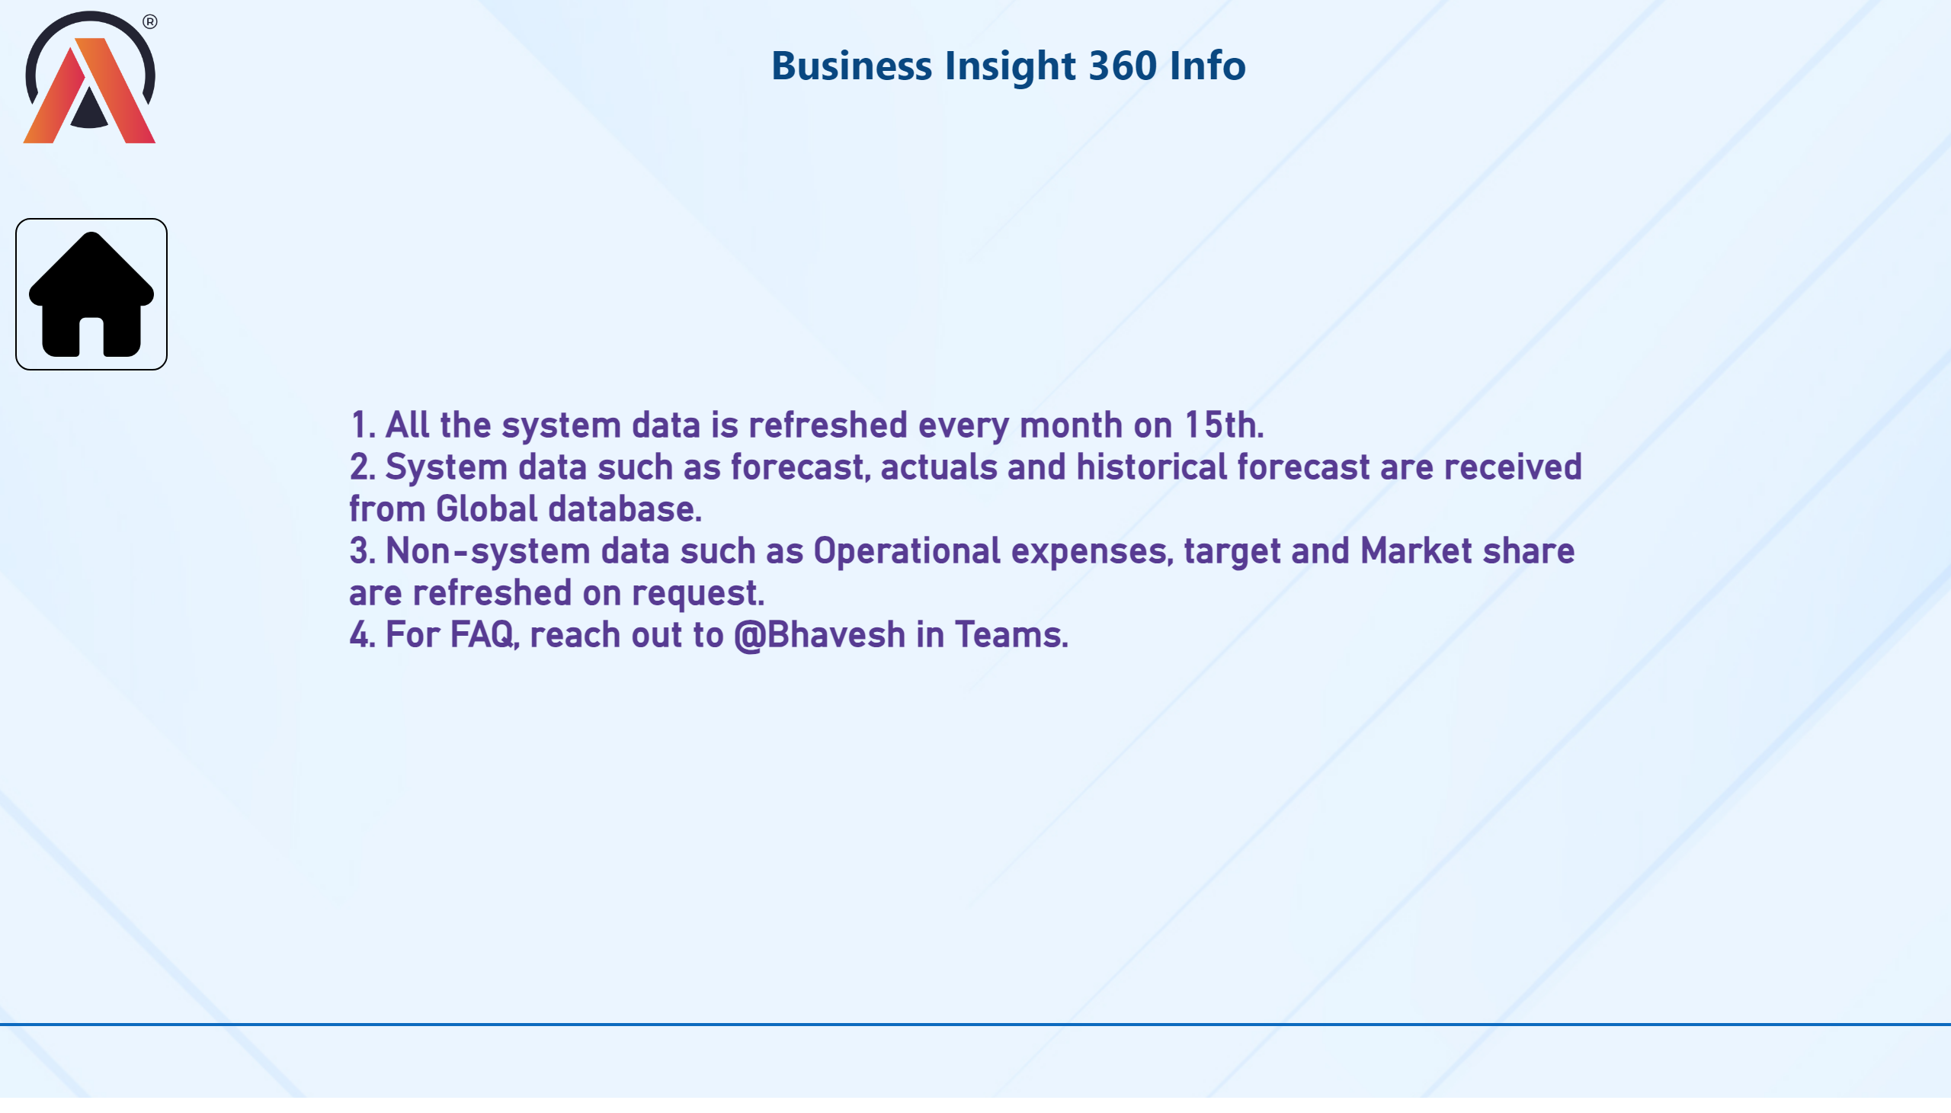
Info
Notes:
textbox
No alt text provided
image
No alt text provided
textbox
No alt text provided
shape
No alt text provided
image
No alt text provided

Slide 11
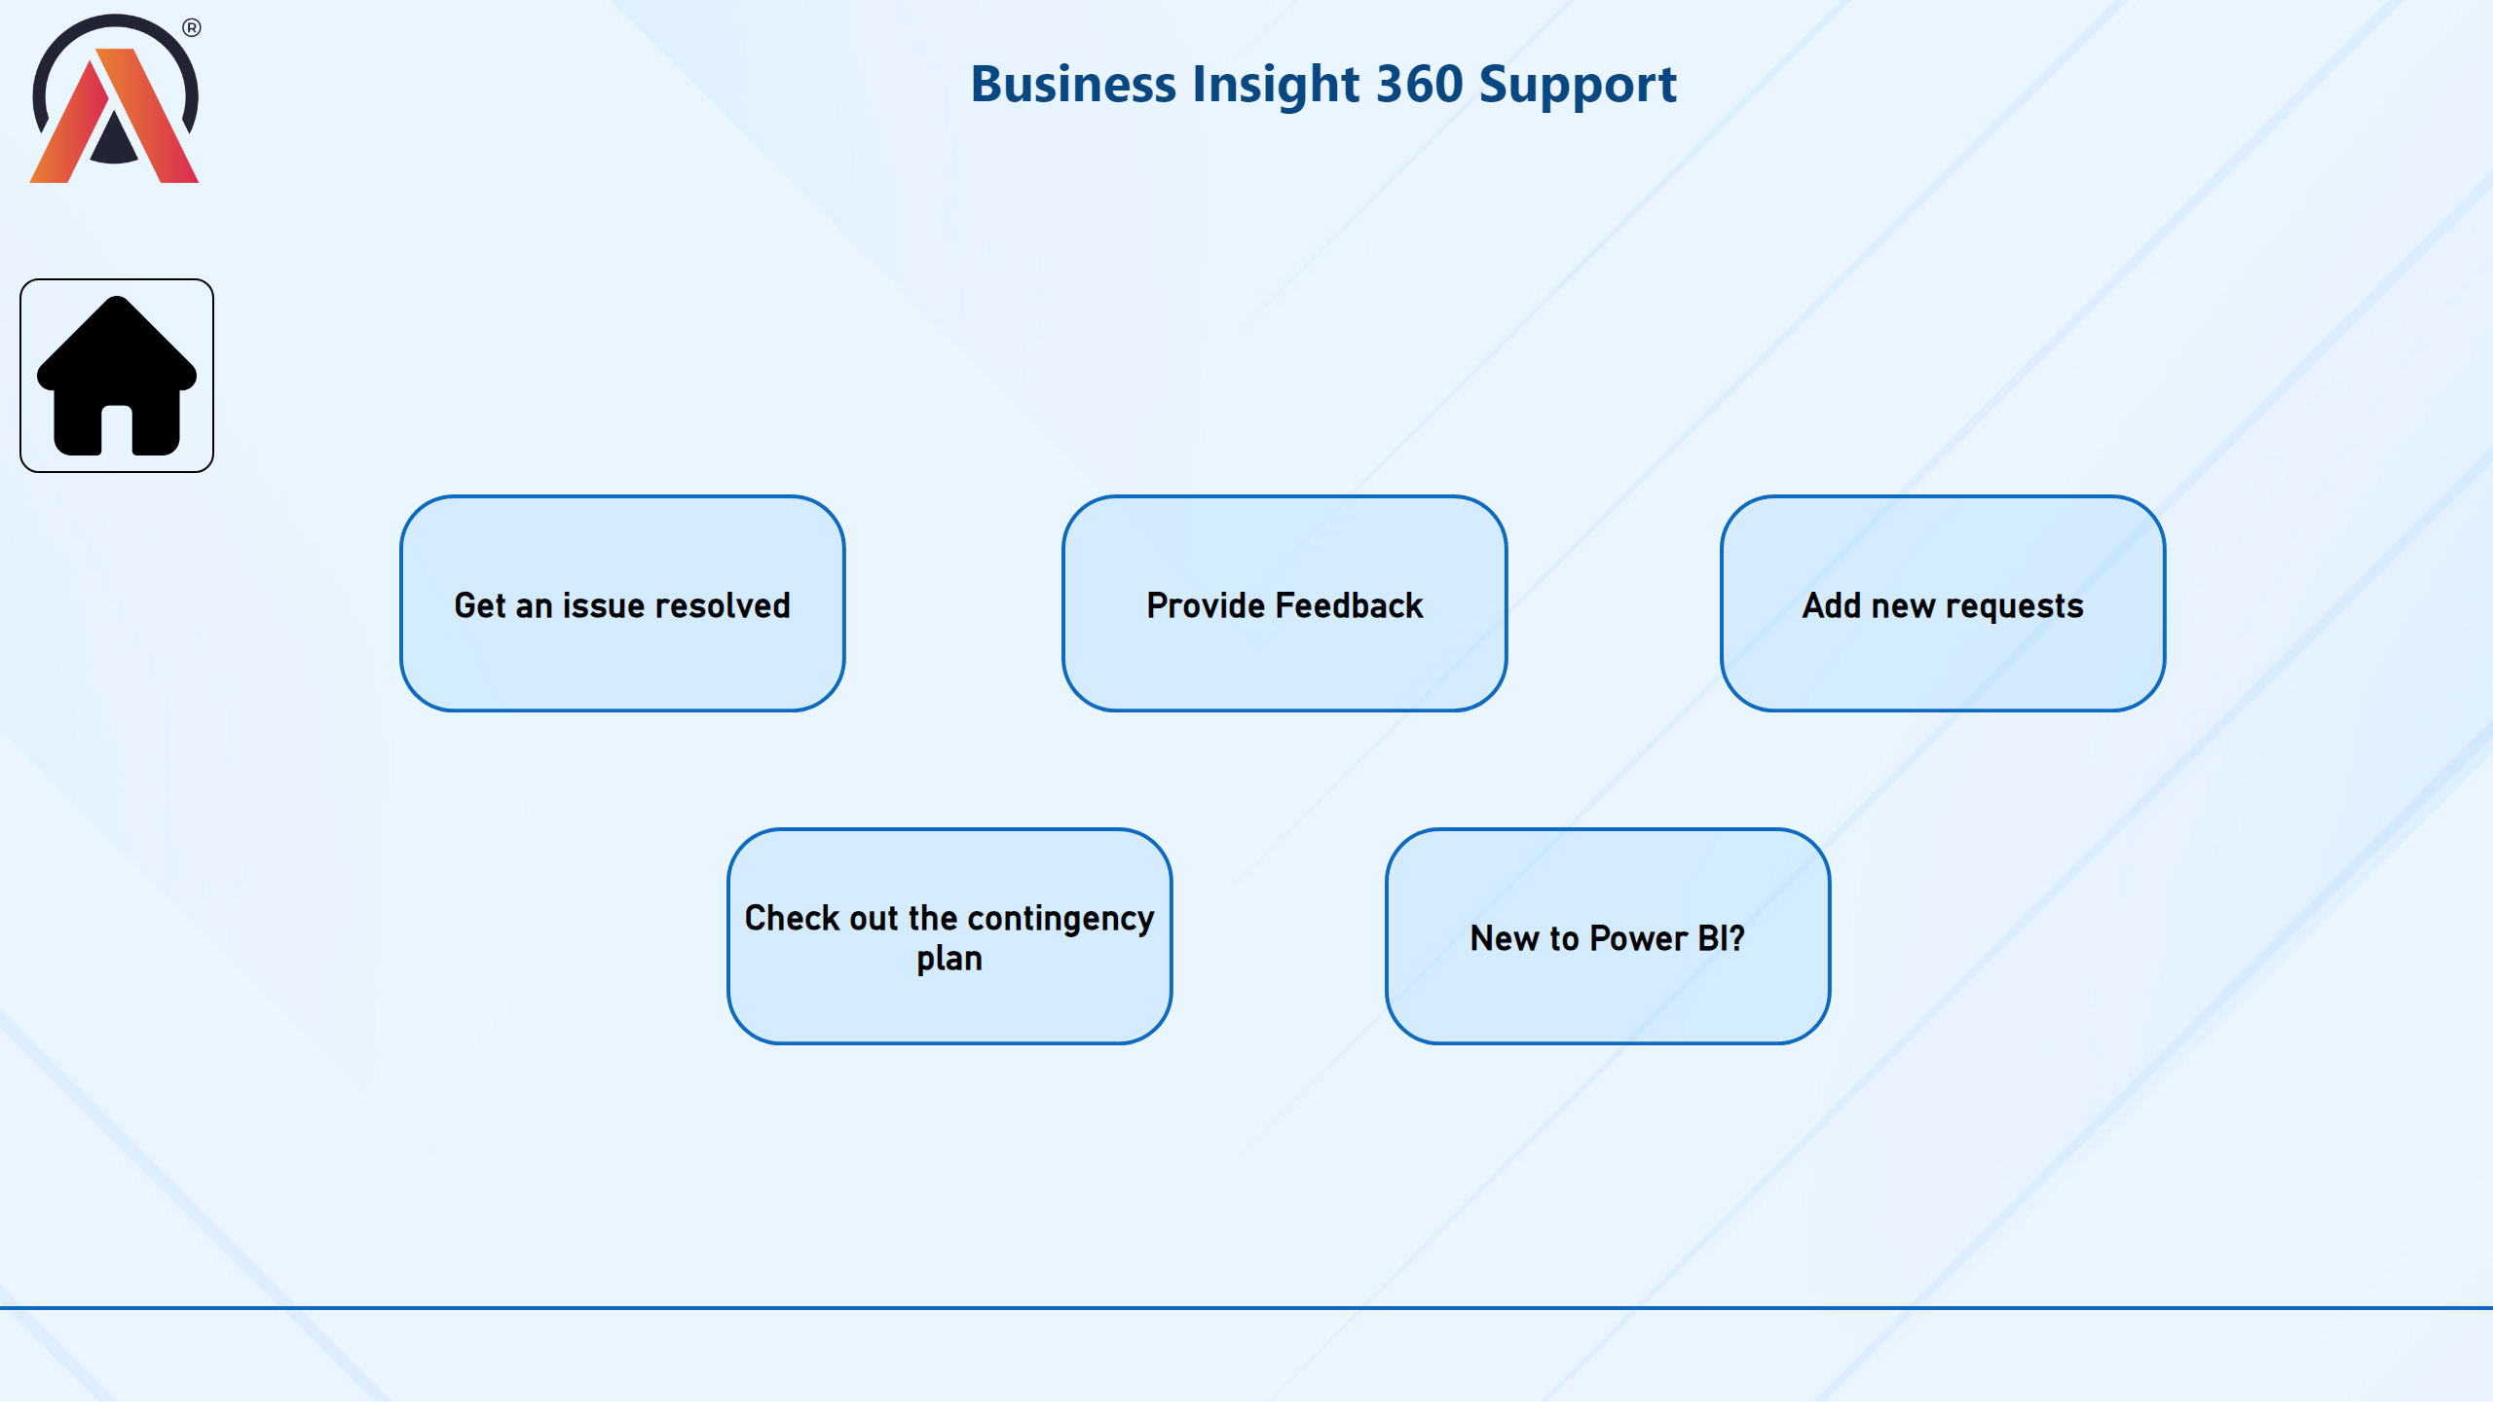
Support
Notes:
textbox
No alt text provided
image
No alt text provided
shape
No alt text provided
image
No alt text provided
shape
No alt text provided
shape
No alt text provided
shape
No alt text provided
shape
No alt text provided
shape
No alt text provided

